Slide 1
SAP CDS view Patrick Wu Package Consultant-SAP HANA SCM PP

Slide 2
Agenda
1
CDS Views Introduction
2
Create CDS View
3
Cardinality
4
Table function
5
VDM type and data category
6
Annotation
Notes:
CDS View 簡介
建立 CDS View
基數

Slide 3
Agenda
1
CDS Views Introduction
2
Create CDS View
3
Cardinality
4
Table function
5
VDM type and data category
6
Annotation
Notes:
CDS View 簡介
建立 CDS View
基數

Slide 4
What is SAP CDS?
SAP CDS stands for SAP Core Data Services.
SAP CDS is an infrastructure for data modelling that enables data models to be defined and consumed on the database server rather than the application server.
enabling users to retrieve data fast, cutting down on application execution time.

Slide 5
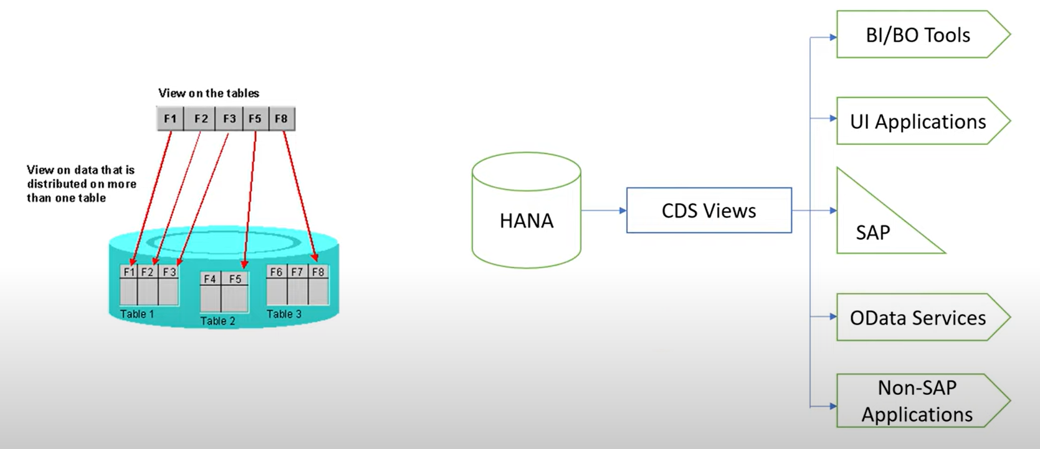
About Core Data Service

Slide 6
What is SAP CDS Views?
Core Data Service (CDS) Views are virtual data models of SAP HANA
SAP CDS Views came into being with SAP’s new programming model. push logic from the application server to the client-side and database.
This is defined by SAP as ‘Code -to-Data’ or ‘Code Pushdown’.

Slide 7
Data Models
In web development, a data model refers to
how data is structured, organized, and managed in a web application.
It’s a blueprint that defines the types of data, their relationships, and how they are stored, retrieved, and manipulated within the system.

Slide 8
Components of a Data Model
Entities/Objects
Attributes/Fields
Relationships(Cardinality)
Data Types
Constraints

Slide 9
Why Data Models Matter in App Development
Consistency
Scalability
Data Integrity
Ease of Development
Constraints

Slide 10
Virtual Data Models (VDM）
It is an abstraction layer that provides a unified and consistent view of data without physically copying or moving it into a single database.
it pulls information from various sources (databases, APIs, files, cloud services, etc.) to create a cohesive view of data that comes from multiple, heterogeneous sources.

Slide 11
How Does a Virtual Data Model Work
Data Abstraction Layer
Data Integration
Query Execution
APIs and Endpoints : Usually access via API, Such as RESTful or GraphQL API

Slide 12
Advantages of a Virtual Data Model
Data Consistency and Integration
Reduced Data Redundancy
Real-Time Data Access
Scalability
Flexibility

Slide 13
Example: CDS view from heterogeneous sources
@AbapCatalog.sqlViewName: 'ZC_SALES_CUST_DATA'
@AbapCatalog.compiler.compareFilter: true
@AccessControl.authorizationCheck: #NOT_REQUIRED
@EndUserText.label: 'Sales Order and Customer Data from Multiple Sources'
define view ZC_Sales_Customer_Data
as select from
ZSalesOrder as SalesOrder
left outer join ZCustomerInteractions as CustomerInteraction
on SalesOrder.CustomerID = CustomerInteraction.CustomerID
{
// Fields from System A
SalesOrder.SalesOrderID,
SalesOrder.CustomerID,
SalesOrder.OrderDate,
SalesOrder.TotalAmount,
// Fields from System B
CustomerInteraction.InteractionDate,
CustomerInteraction.InteractionType,
CustomerInteraction.Comments
}
Scenario
Imagine you have an SAP system that needs to pull data about Sales Orders from two different systems:
System A: An on-premises ERP database containing sales orders and customer information.
System B: A cloud-based CRM that stores customer feedback and interaction logs.

Slide 14
Types of CDS Views
HANA CDS Views
ABAP CDS Views

Slide 15
Advantages of CDS Views
CDS Views can be exposed as an OData Service for accessing and extracting SAP data.
CDS Views are database independent and are comparable to Open SQL.
CDS views support open SQL and they can be called in the same way as an SE11 view to the application layer.

Slide 16
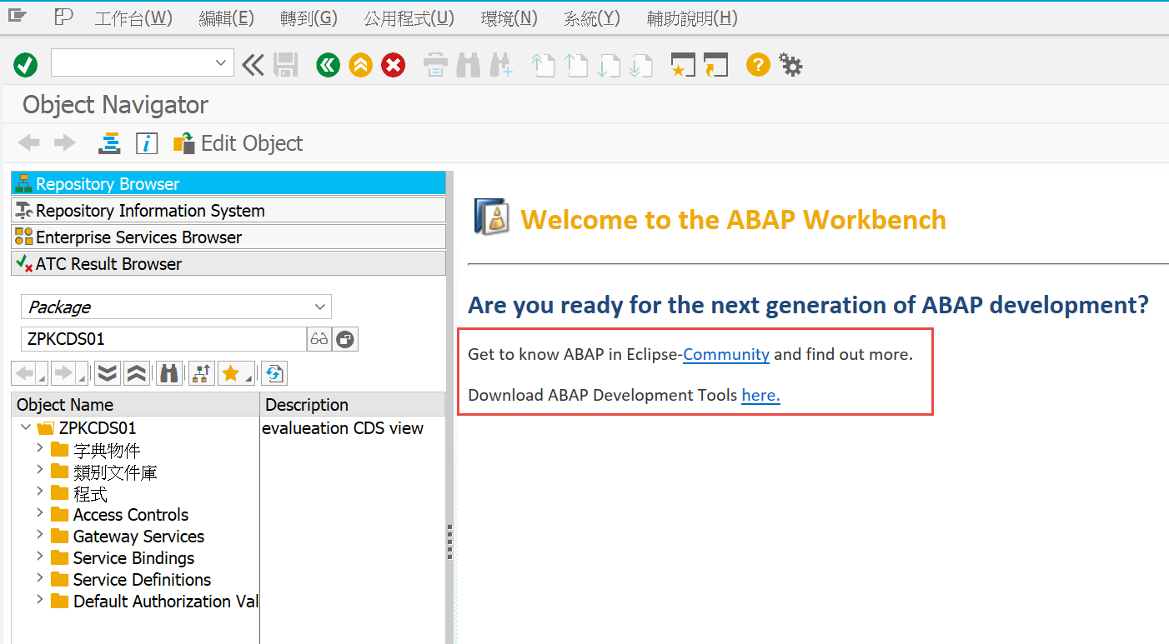
CDS Views – Platform for Practice
HANA System.
HANA Studio or Eclipes.
Above tools has ADT included.
Get to know ABAP in Eclipse-Community and find out more.
Download ABAP Development Tools here.

Slide 17
Agenda
1
CDS Views Introduction
2
Create CDS View
3
Cardinality
4
Table function
5
VDM type and data category
6
Annotation
Notes:
CDS View 簡介
建立 CDS View
基數

Slide 18
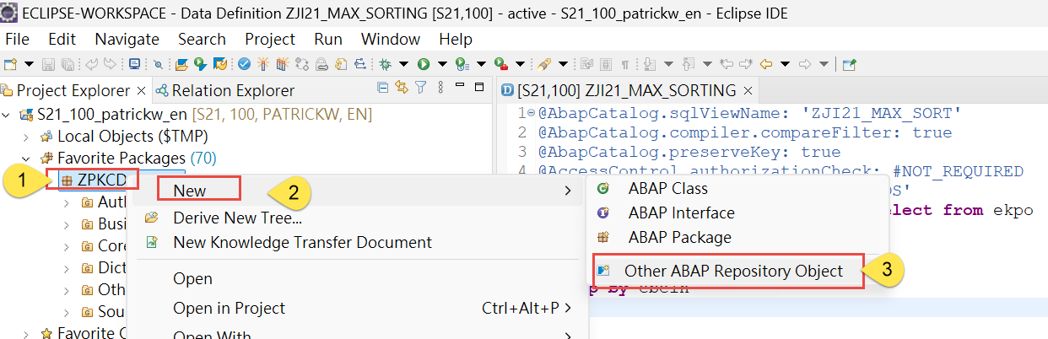
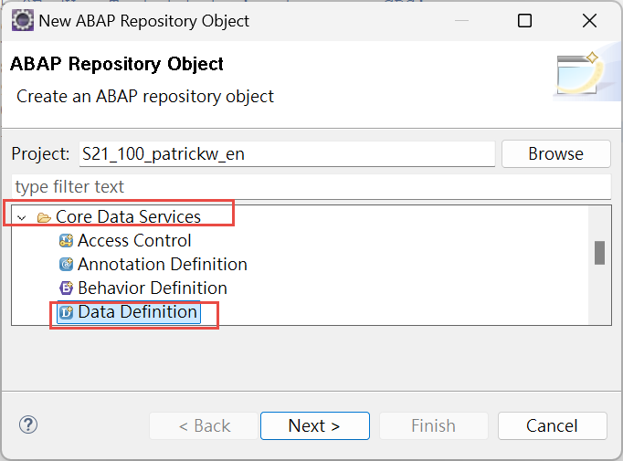
CDS Views – Creating via Eclipse(1/5)
New other ABAP Repository Object in Package

Slide 19
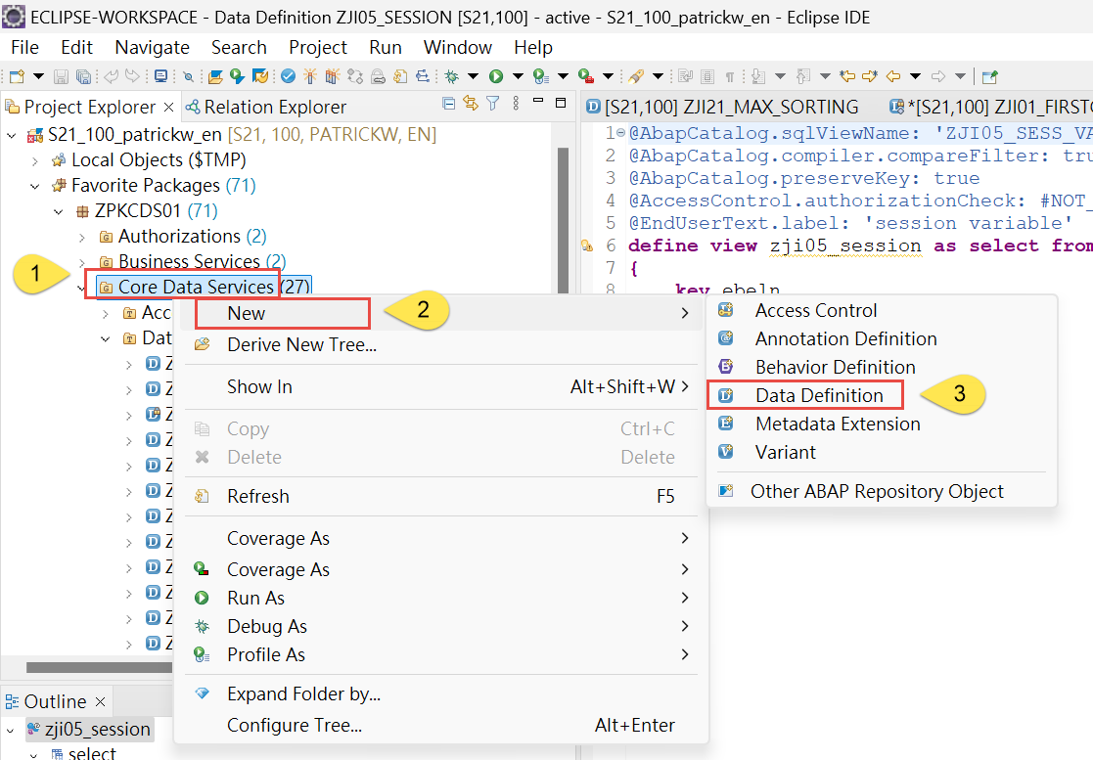
CDS Views – Creating via Eclipse(2/5)
New Data Definition under Core Data Services

Slide 20
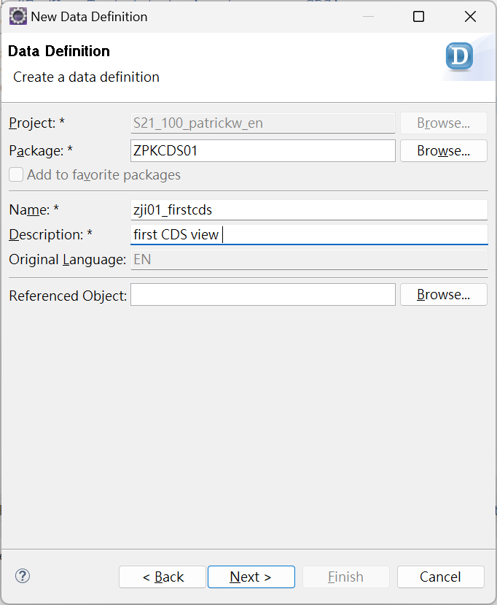
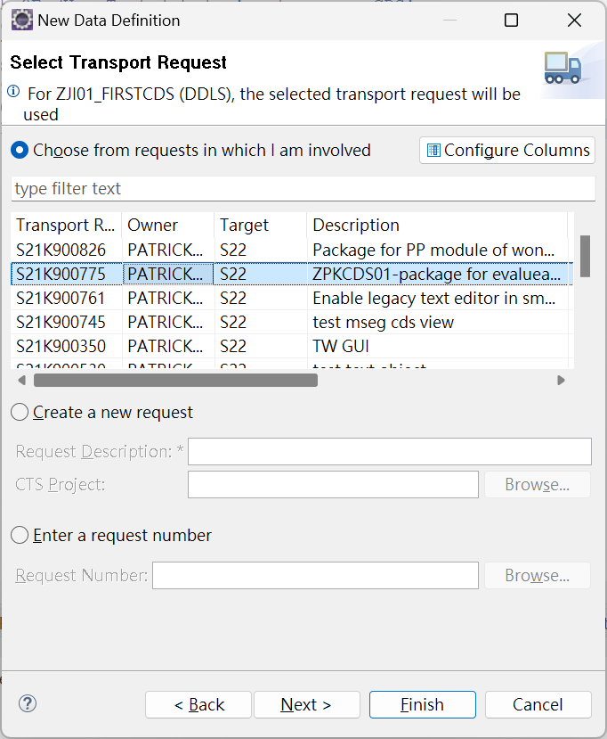
CDS Views – Creating via Eclipse(3/5)
Naming and assign transport request

Slide 21
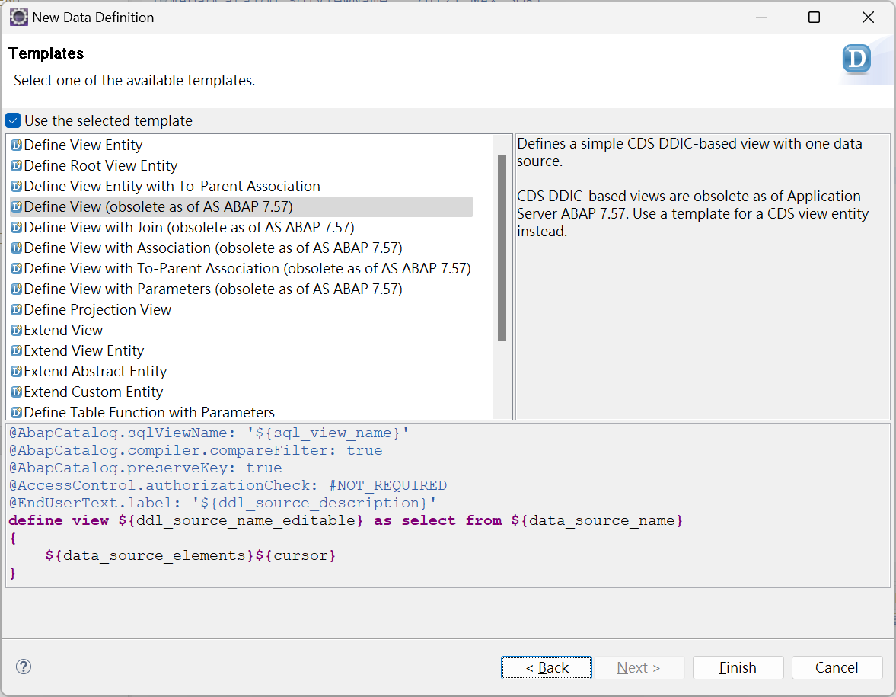
CDS Views – Creating via Eclipse(4/5)
Select template

Slide 22
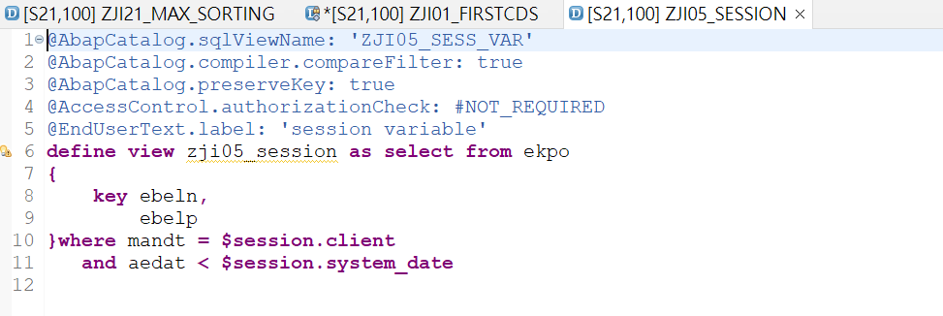
CDS Views – Creating via Eclipse(5/5)
Define data source of CDS view

Slide 23
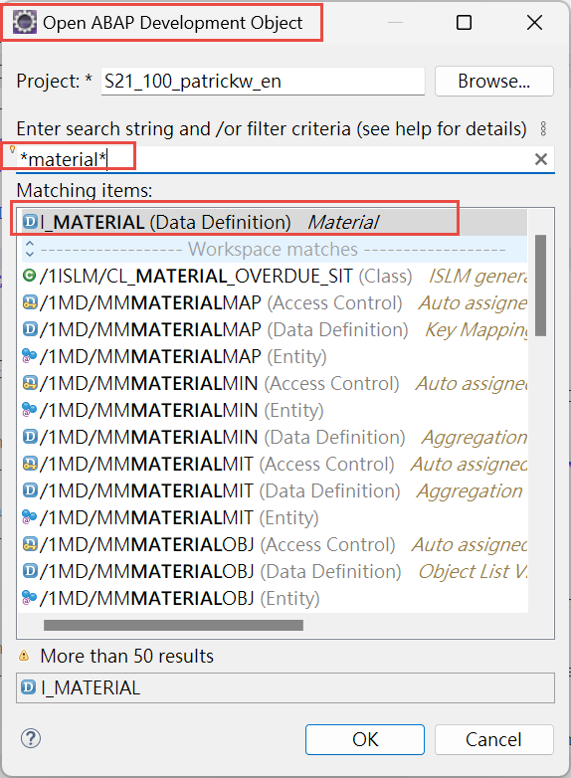
CDS Views -- Join
Session variable : $session
Parameter : $parameter
Search CDS view
Virtual Data Model and CDS Views
Inner Join
Left outer join
Right outer join
Notes:
}

Slide 24
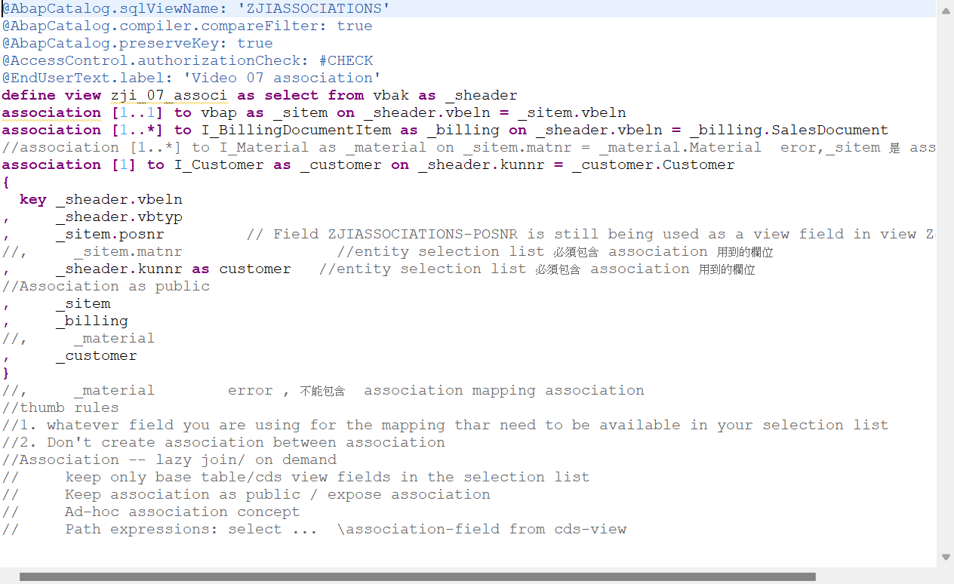
CDS Views -- Association
Replace ‘inner join’ with ‘association [X..X] to’
Entity selection list must include fields in association and others CDS view
You have to keep alias name of association entity as a public one
Don't create association between association
Association is a lazy join or on demand join
Join and Association depend on data volume and complexity

Slide 25
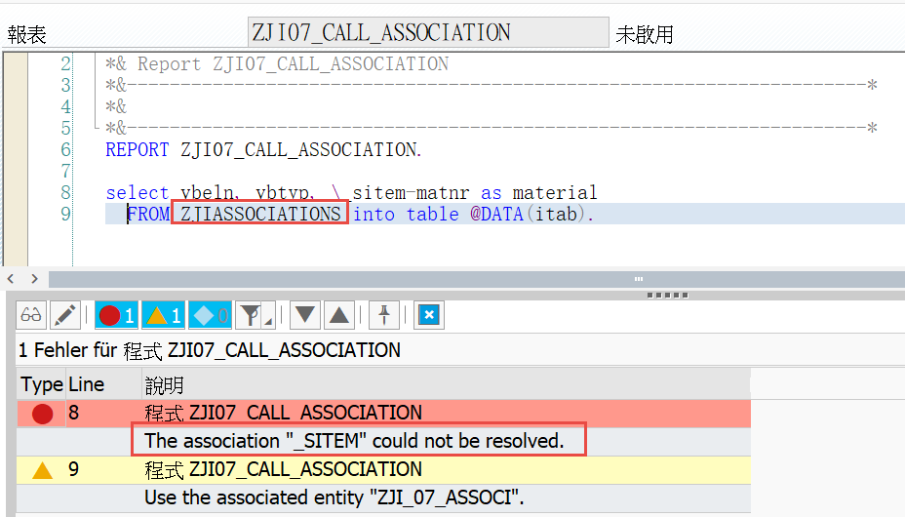
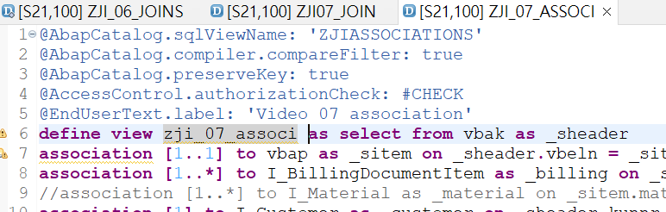
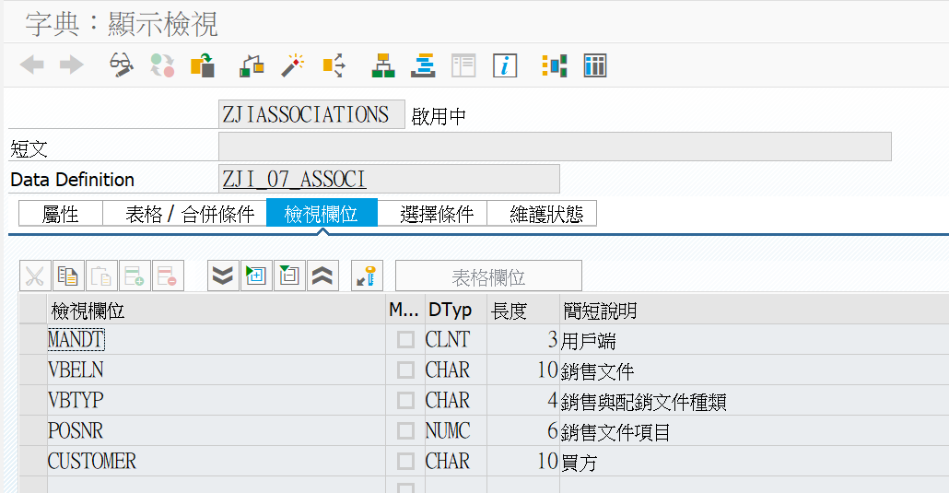
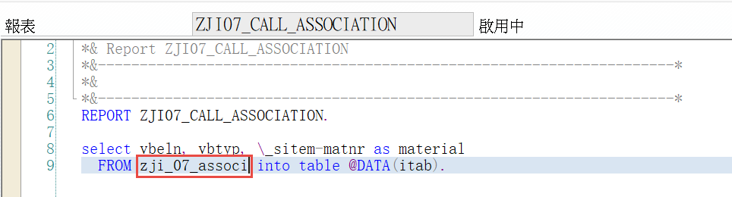
Path expressions– access cds view in ABAP
select ... \association-field from cds-view, Using CDS entity name instead of sqlviewname
錯誤語法範例
正確語法範例

Slide 26
Associations — Lazy Join / On demand
Keep only base table/CDS View fields in Selection List
Keep association as public / expose association **
Ad-Hoc Association : association name dot field name
Path Expressions

Slide 27
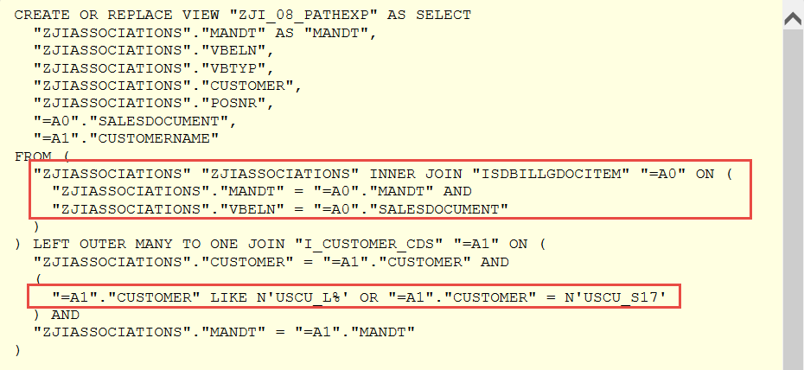
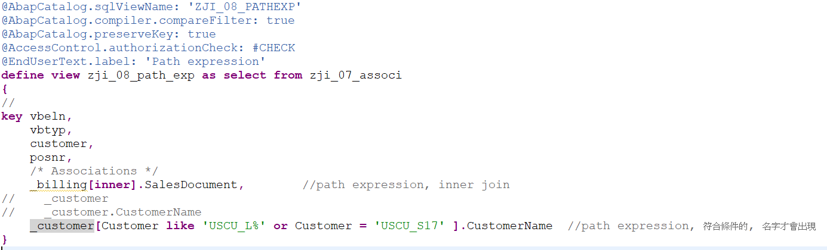
Path expressions
Show SQL CREATE statement
Change the default outer join as inner join.

Slide 28
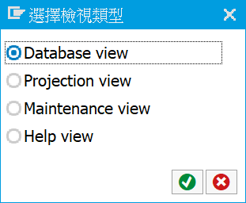
CDS view compared to ECC views(1/3)
Various views in the ECC system
Database view
Projection view
Help view
Maintenance view

Slide 29
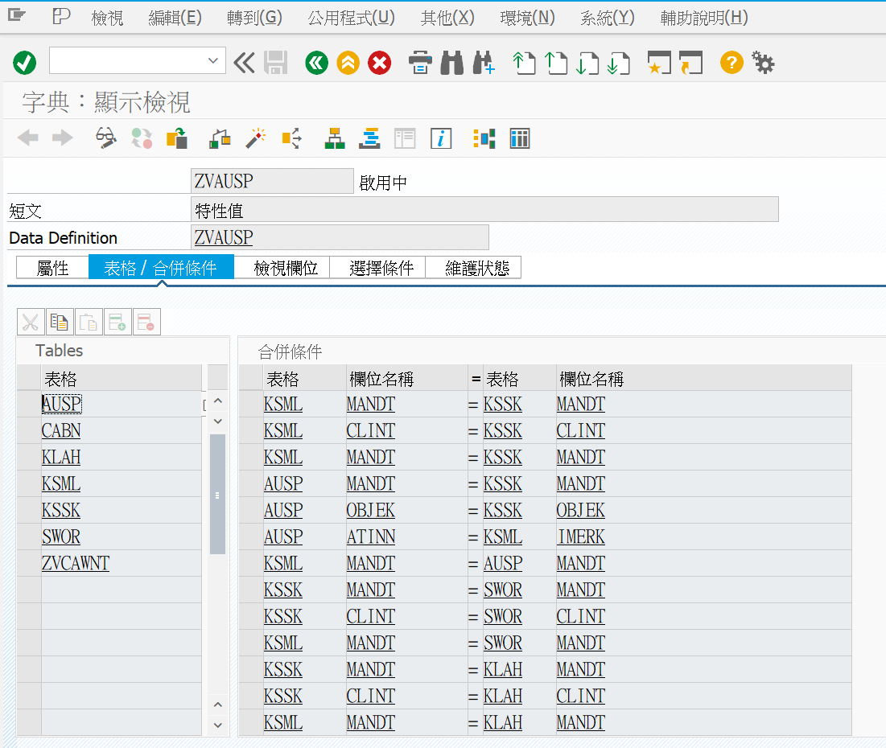
CDS view compared to ECC views(2/3)
Maintain via Tcode SE11 ABAP dictionary

Slide 30
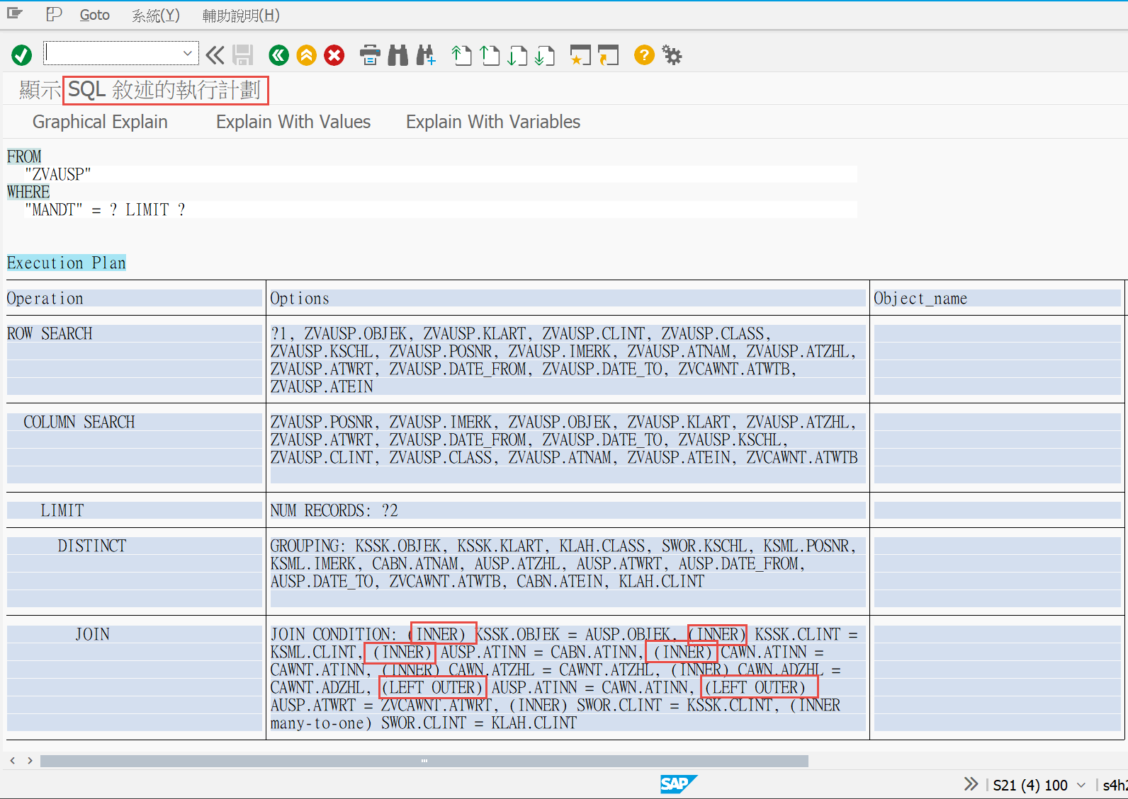
CDS view compared to ECC views(3/3)
Using join to relate different data sources

Slide 31
Agenda
1
CDS Views Introduction
2
Create CDS View
3
Cardinality
4
Table function
5
VDM type and data category
6
Annotation
Notes:
CDS View 簡介
建立 CDS View
基數

Slide 32
Basic idea about Cardinality in CDS association
Cardinality[Source Min..Target Max] => Cardinality[Target Min..Target Max]
Cardinality is optional, defaultis [0..1]
Cardinality possible values are, 0..1, 1..1, 0..*,1..*, 1, 2, 3 and so on.
‘Show SQL CREATE statement’ will help more to understand the results of cardinality.

Slide 33
Cardinality
[Min..Max] of the target data
[Max..Min] is not possible because maximum value is always greater than the minimum value
Material description [1..1] [0..1] [1..*]
Sales header and items [1..1] [0..1] [1..*]
[1] – default and work for all scenarios

Slide 34
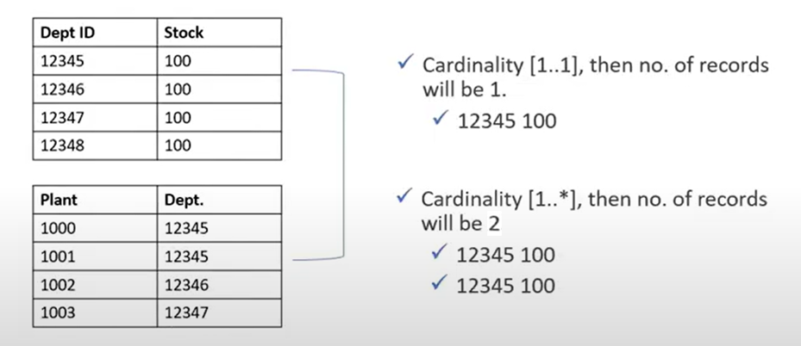
Cardinality – one to one vs one to many

Slide 35
Cardinality – Business scenario(1/7)
PO 1, 2 items, 0 delivery
PO 2, 1 item, 21 deliveries
Simple scenario with standard tables
CDS with Master details
UI Application
Source : PO detail (header, and Delivery )
CDS with Item count
Cardinality [1..1]
Cardinality [1..*]
CDS with delivery count

Slide 36
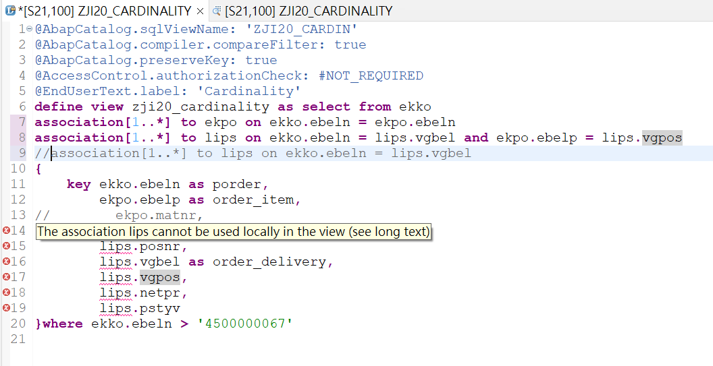
Cardinality – Business scenario(2/7)
Association mapping association

Slide 37
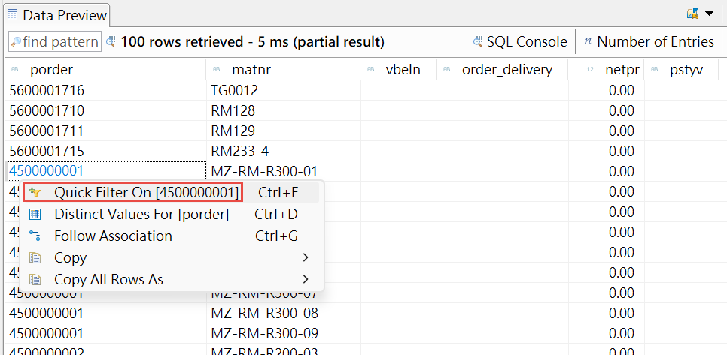
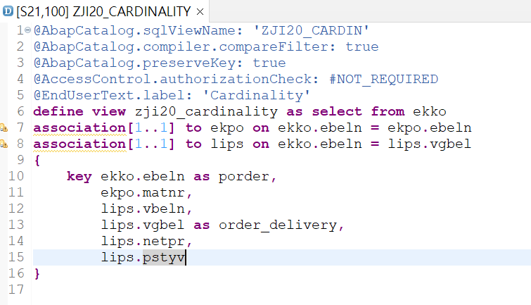
Cardinality – Business scenario(3/7)
Cardinality [1..1]

Slide 38
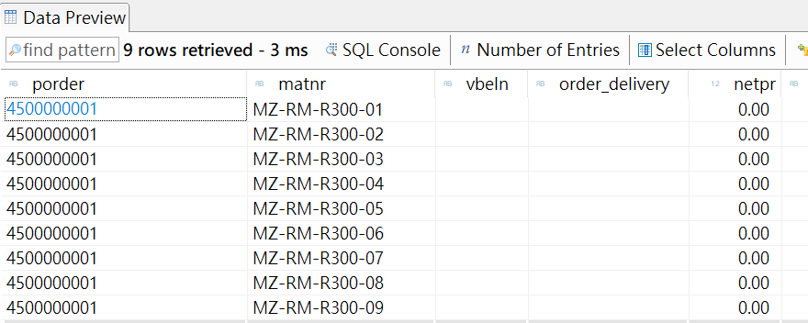
Cardinality – Business scenario(4/7)
Cardinality [1..1]

Slide 39
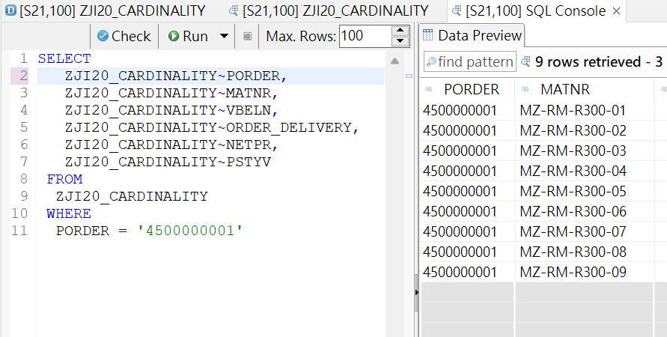
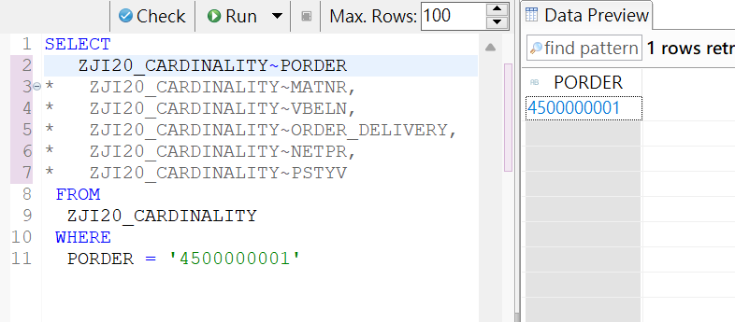
Cardinality – Business scenario(5/7)
Understanding cardinality with the help of SQL console

Slide 40
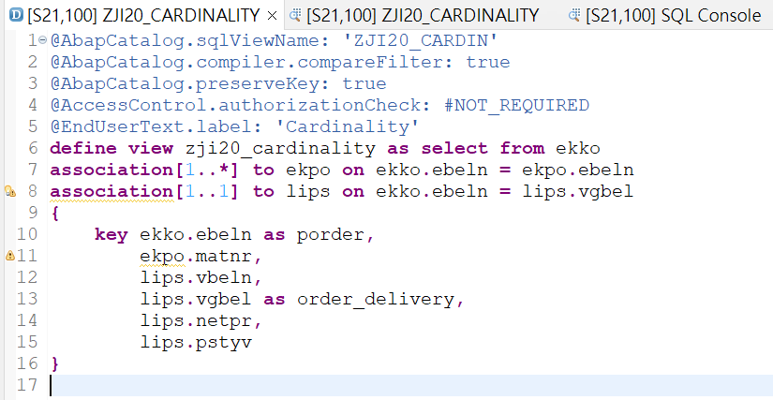
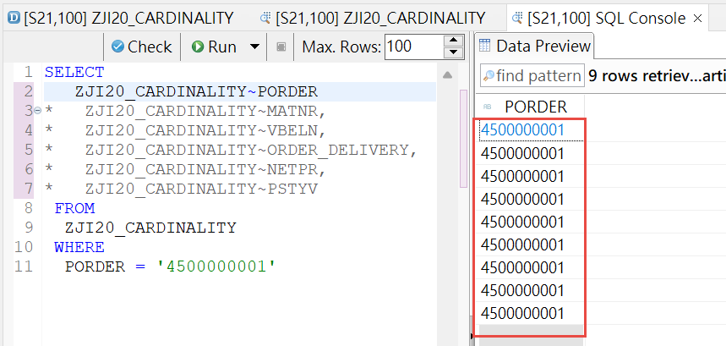
Cardinality – Business scenario(6/7)
Cardinality [1..*]

Slide 41
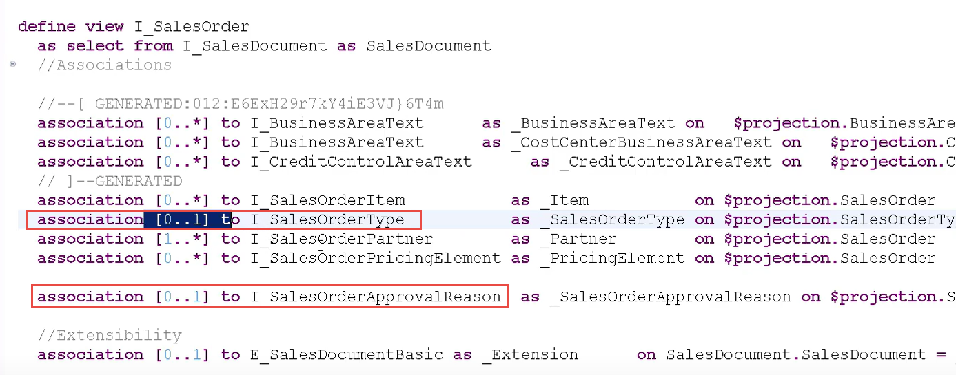
Cardinality – Business scenario(7/7)
Cardinality [1..1] 實務範例

Slide 42
CDS View -- $projection(1/6)
To make a reference to an element of the SELECT list in the ON condition, the field name can be prefixed with $projection instead of the source data source.
In this case, an alternative element name defined using AS can be specified instead of the field name.
If a path expression of the SELECT list is used when the prefix $projection is used in the ON condition, the current association cannot itself be used in the SELECT list, to avoid invalid join expressions.

Slide 43
CDS View -- $projection(2/6)
@AbapCatalog.sqlViewName: 'SALESO_INVHDR_VW' define view sales_order_invoice_header as select from snwd_so_inv_head inner join snwd_so on snwd_so_inv_head.so_guid = snwd_so.node_key association [1..1] to snwd_bpa as _buyer on $projection.buyer_guid = _buyer.node_key association [1..*] to snwd_so_inv_item as _invoice_items on $projection.node_key = _invoice_items.parent_key { key snwd_so_inv_head.node_key, //used in assoc _invoice_items snwd_so_inv_head.buyer_guid, //used in assoc _buyer snwd_so.so_id as sales_order_id, _buyer.bp_id as buyer_id, //from assoc _buyer snwd_so_inv_head.payment_status, @Semantics.currencyCode snwd_so_inv_head.currency_code, @Semantics.amount.currencyCode: 'currency_code' snwd_so_inv_head.gross_amount, _invoice_items //publish assoc _invoice_items } where _buyer.bp_role = '001'; //usage of assoc buyer
The source data source fields used in the ON conditions - node_key and buyer_guid - are part of the SELECT list. Here the prefix $projection is used instead of the prefixes snwd_so_inv_head or snwd_so_inv_head.
The association _buyer is not listed in the SELECT list and can only be used in path expressions of the current SELECT statement. This association can be specified in the WHERE condition due to the cardinality [1..1].
The association _invoice_items is listed in the SELECT list, which means it can be used in path expressions of other CDS views. This association cannot be specified in a WHERE condition due to the cardinality [1..*].

Slide 44
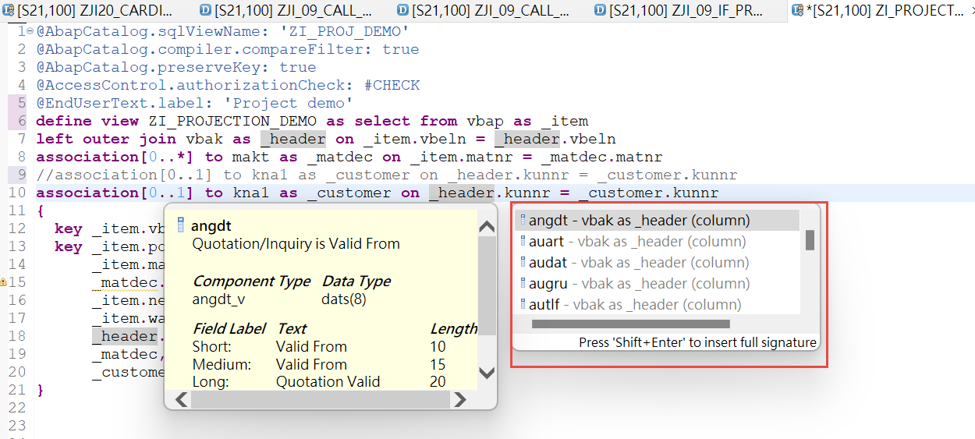
CDS View -- $projection(3/6)
An example of Association with alias, all fields of association could be selected

Slide 45
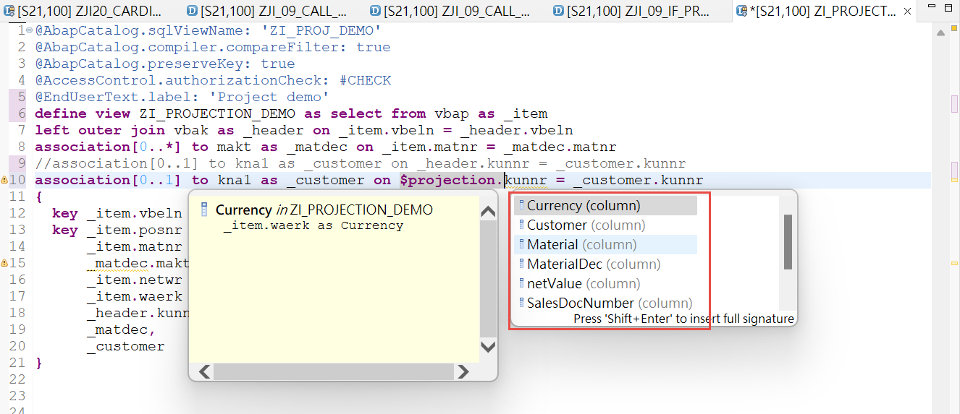
CDS View -- $projection(4/6)
The prefix $projection is used instead of the alias, only fields in Select list could be selected

Slide 46
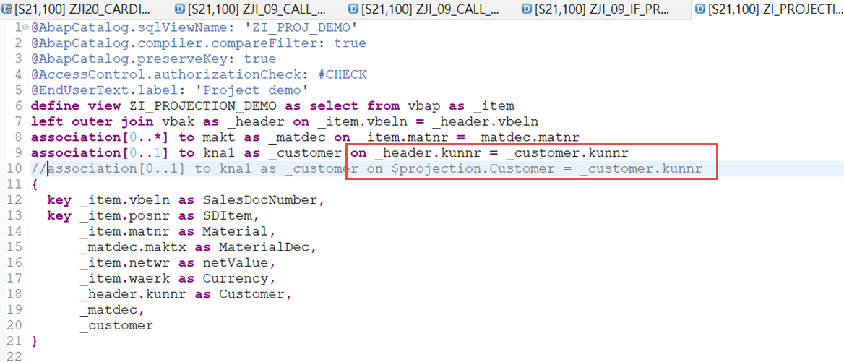
CDS View -- $projection(5/6)

Slide 47
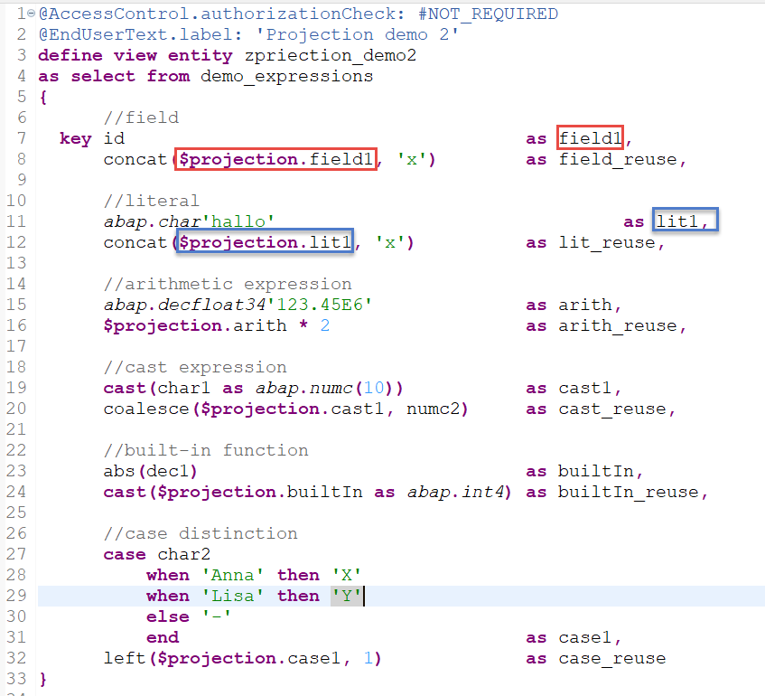
CDS View -- $projection(6/6)
Fields from select list

Slide 48
Agenda
1
CDS Views Introduction
2
Create CDS View
3
Cardinality
4
Table function
5
VDM type and data category
6
Annotation
Notes:
CDS View 簡介
建立 CDS View
基數

Slide 49
CDS view – Table function
Additional Functionalities which is not supported in the CDS. For example: “Orderby”is not possible in ABAP CDS View；
Write SQL statements for the requirement.
SQL Script functions and methodologies.

Slide 50
Table function Design
Has optional inputparameters.
Has return parameters(multiple records). -- Kind of internal table
Needs Class and Methods to define.一 Class:Public, Method:Static.
Interface: IF_AMDP_MARKER_HDB.

Slide 51
Table function Technical Design
Create table function
define class and methods
consume table function in CDS view
CDS View 1
CDS View 2
3
Table Function
1
2
Class and Methods

Slide 52
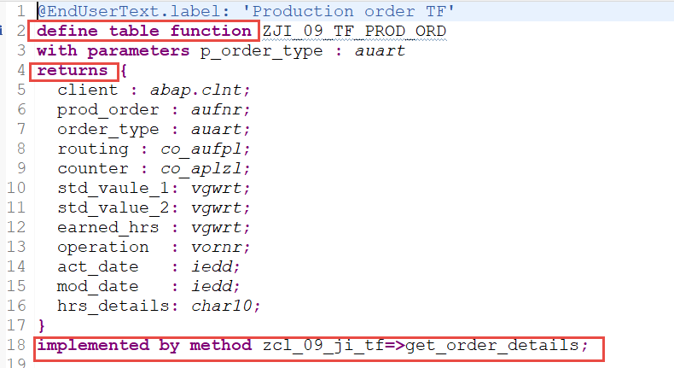
Create table function
Key words
Define Table function
Return
Implemented by method
With Parameters (optional)

Slide 53
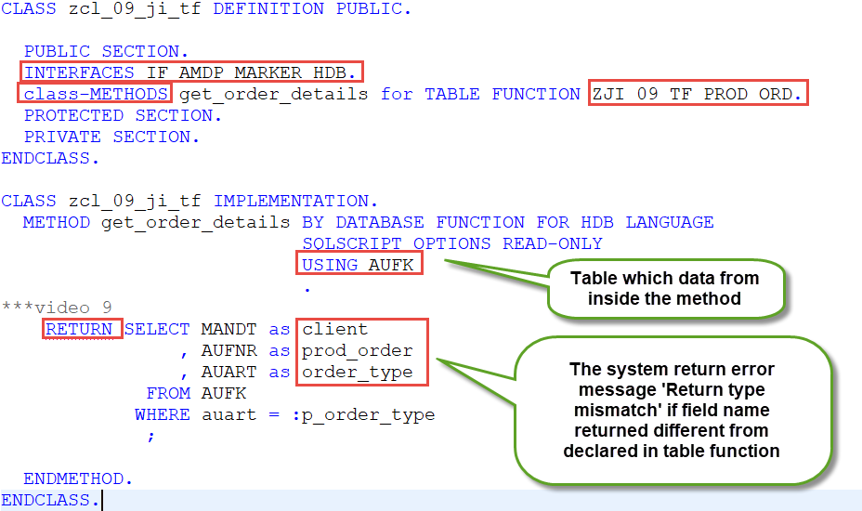
define class and methods for table function
Key words
Implement interface IF_AMDP_MARKER_HDB
Declare class method
Return result
Error
XXXX is unknown. ABAP objects and DDIC objects must be declared in the USING clause …
return type mismatch …

Slide 54
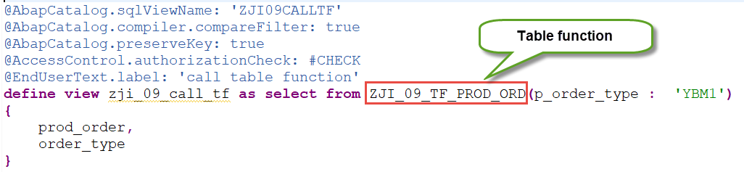
Consume table function in CDS view(1/2)
Simple case

Slide 55
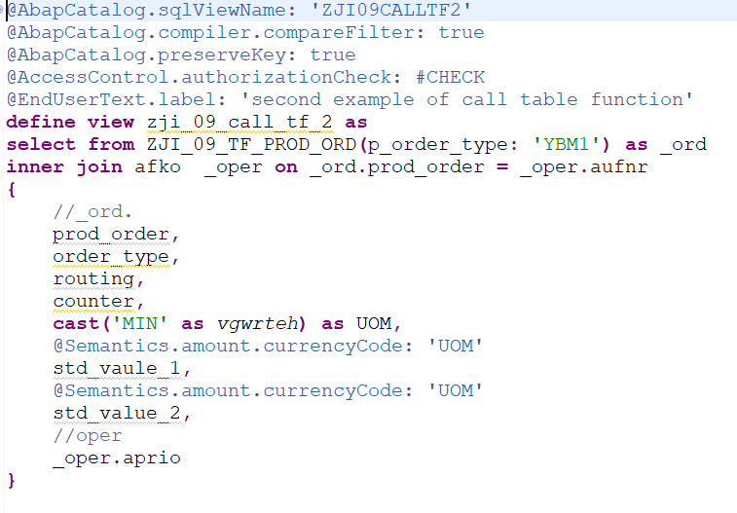
Consume table function in CDS view(2/2)
Join table function and table

Slide 56
Table function concept /methodology
Based on the previous data, get the records from database table.
Local variable declaration.
Data handling in the SQL statement.
SQL Functions.
Usage of table DUMMY.
IF condition.

Slide 57
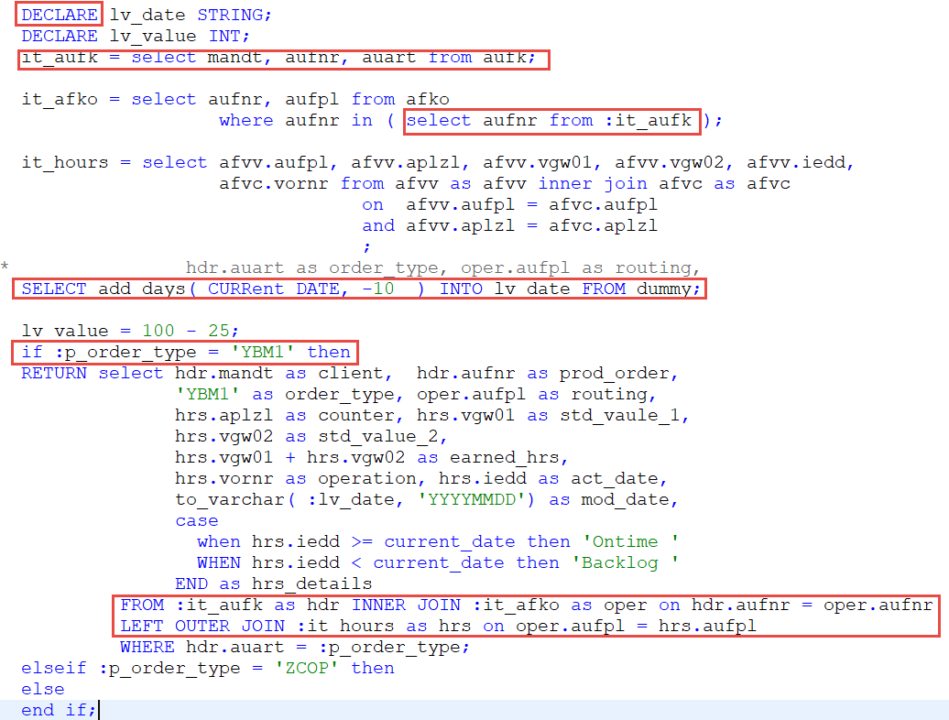
Table function-- Local variable declaration
Declare local variable.
Declare internal table in the select statement.
Usage of table DUMMY
IF condition.

Slide 58
CDS View with sorting process
“Orderby”is not possible inABAP CDS View.
Alternative option to achieve this process.
Table Function.
In CDS with MAX function.

Slide 59
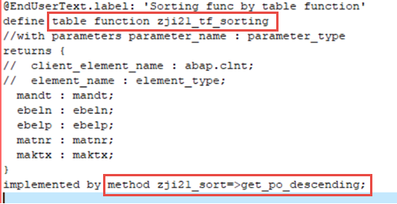
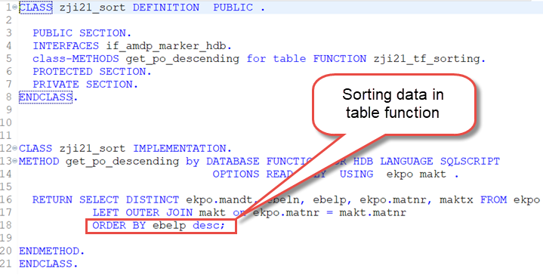
CDS View sorting via table function

Slide 60
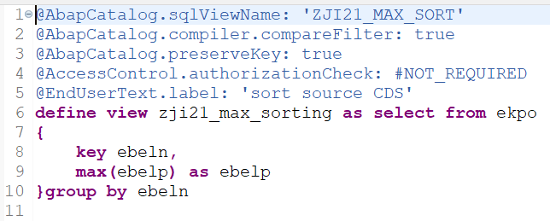
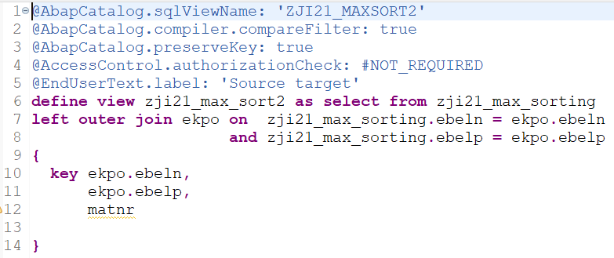
CDS View sorting via MAX function

Slide 61
Agenda
1
CDS Views Introduction
2
Create CDS View
3
Cardinality
4
Table function
5
VDM type and data category
6
Annotation

Slide 62
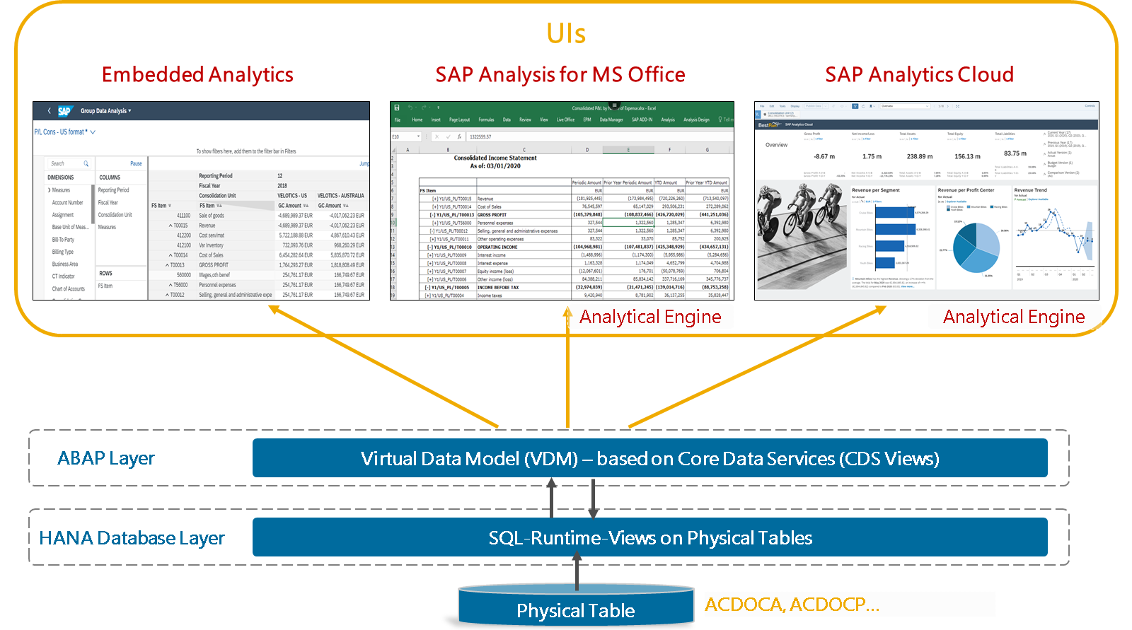
Virtual Data Model(VDM)

Slide 63
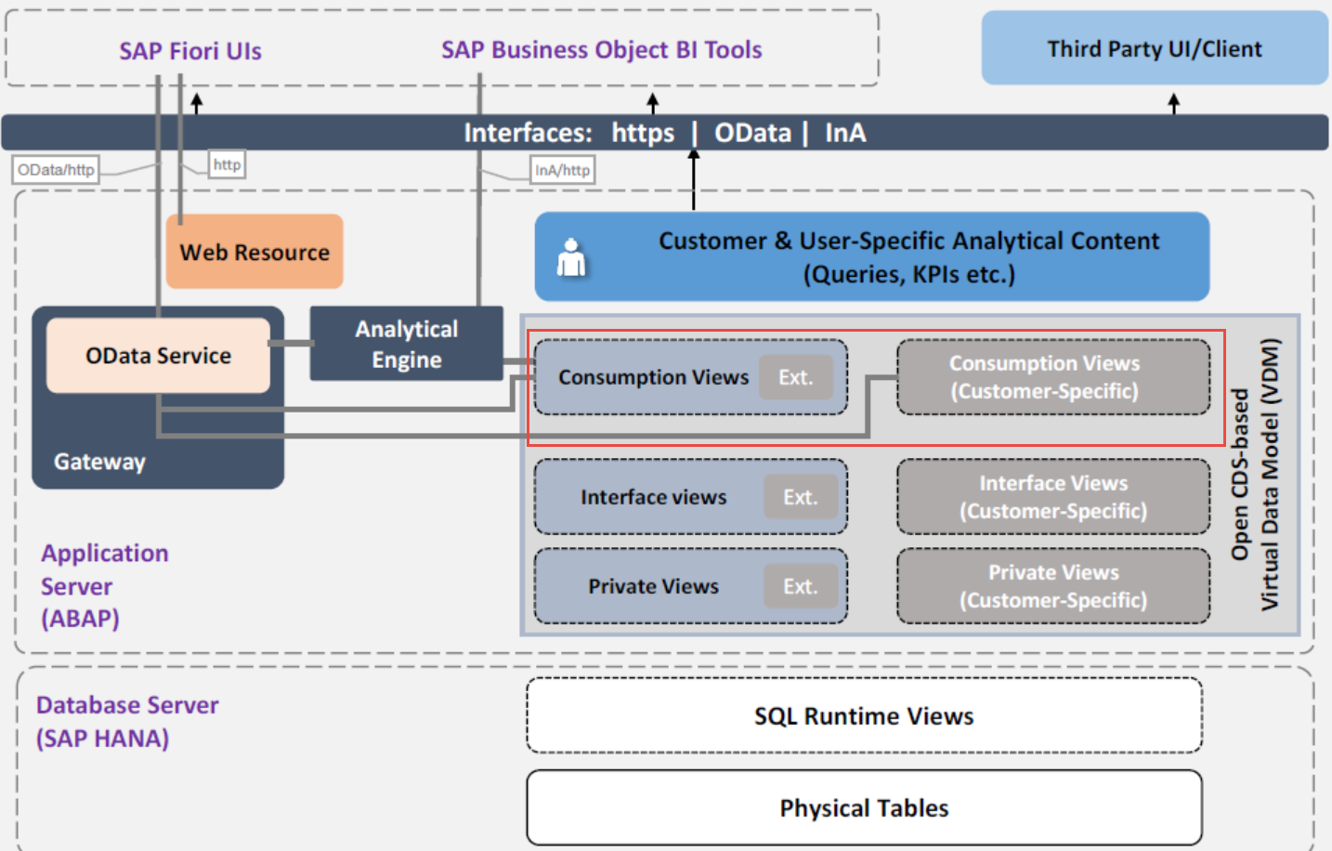
VDM Consumption views

Slide 64
Benefits of VDM
Improved performance
Extensibility
Security and privacy: Full ABAP integration, allowing for instance to re-use existing reporting authorizations, etc.
Consistence: Build consistent calculations like deviations, margins etc.
CDS Views are not application-specific but across-applications due to Joins but without redundant physical data.

Slide 65
About VDM (Virtual Data Model) Functionality
Enriched Data Model
VDM is intended to be interpreted by view browsers and other functionality which is based on the virtual data model. So, these views can be consumed directly by rich client UIs (such as HTML5, SAP BusinessObjects, and Excel) without any additional software layer.
VDM View Types
‧ Basic
‧ Composite
‧ Consumption

Slide 66
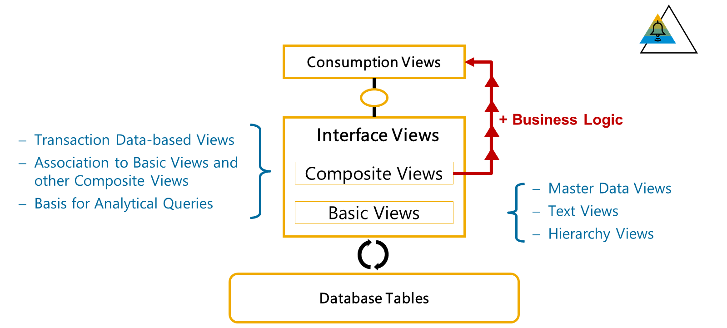
VDM View Types
Basic
Composite
Consumption

Slide 67
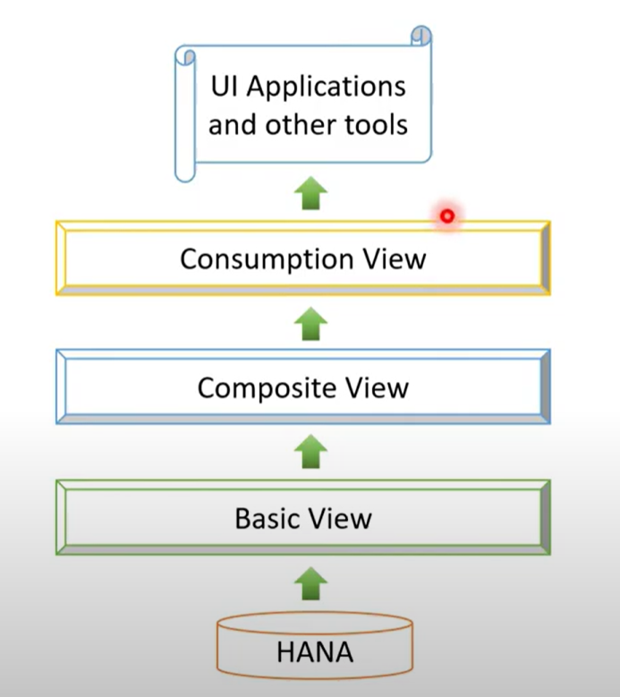
Hierarchy of VDM types
Basic
Created on top of DDIC tables/views
Interact with DB to fetch data
Source: Table/View
Syntax: @VDM.Viewtype: #BASIC
Composite
Created on top of BASIC view
Doesn't interact with DB to fetch data
Multiple Basic views can be used
Source: Basic View
syntax: @VDM.Viewtype: #COMPOSITE
Consumption
created on top of COMPOSITE view
Doesn't interact with DB/Basic Views
‧ Expose data: UIS, HTML, Excel, BO Lumira?...
Source: Composite View
Syntax: @VDM.Viewtype: #CONSUMPTION

Slide 68
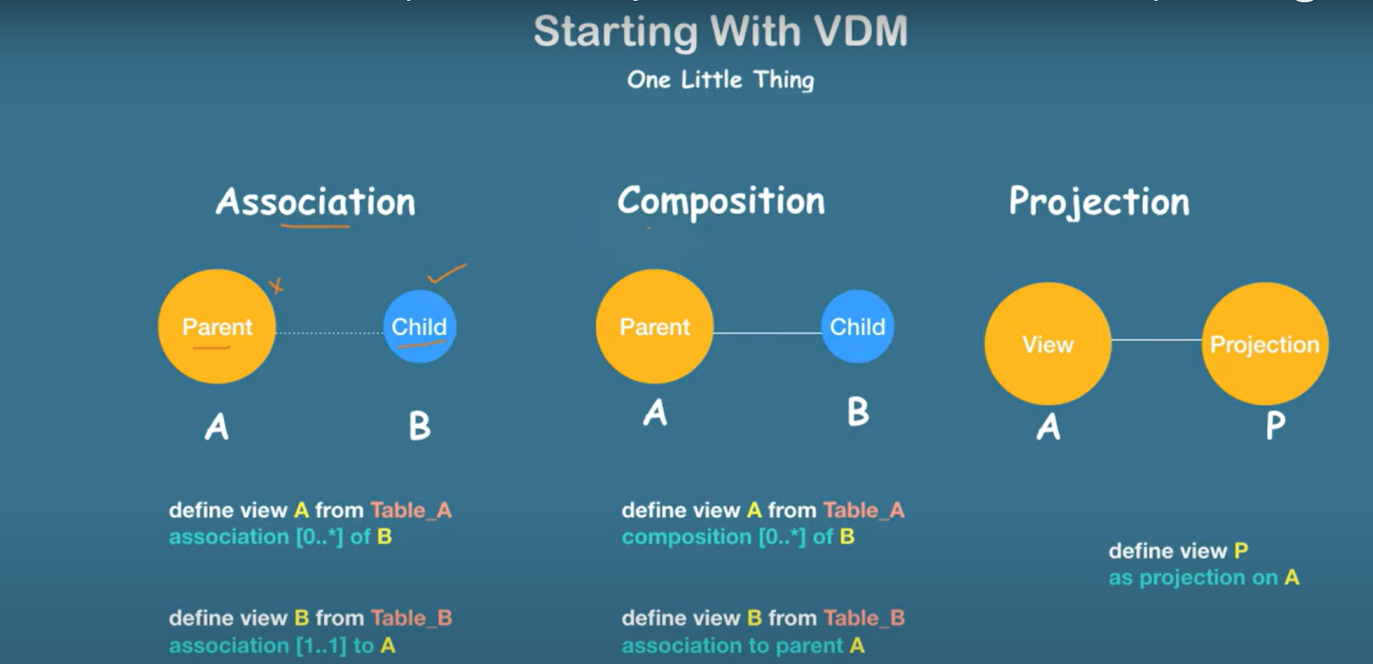
CDS Association, Composition and Projection

Slide 69
CDS View Data Category
Define your data based on the business requirement.
Data Category Types
Dimension
Fact
Cube

Slide 70
Data Category Types
Dimension
Represents Master Data
Syntax: @Analytics.dataCategory: #DIMENSION.
Fact
Represents Transaction Data
Contains measures.
Should not be joined with Master data views
Syntax: @Analytics.dataCategory: #FACT.
Cube
Represents Transaction Data (like #FACT)
Can be joined with Master data views
Consumption views are built on top of Cube
Syntax: @Analytics.dataCategory: #CUBE.

Slide 71
Complete CDS view: (VDM + Data Category)
Composite View:
Created on top of BASIC view
Multiple Basic views can be used
Source: Basic View
syntax: @VDM.Viewtype: #COMPOSITE
Transaction data
Consumption
Composite
Basic
Master data
Dimension
Dimension
@VDM.viewType: #CONSUMPTION
@Odata.publish: #TRUE
@VDM.viewType: #Basic
@Analytics.dataCategory: #Dimension
@VDM.viewType: #COMPOSITE
@Analytics.dataCategory: #CUBE
@VDM.viewType: #Basic
@Analytics.dataCategory: #Dimension
@VDM.viewType: #Basic
@Analytics.dataCategory: #FACT

Slide 72
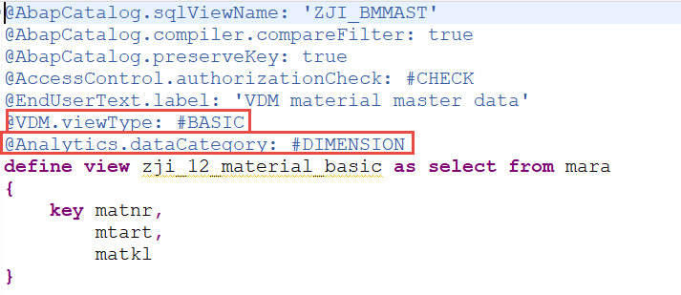
Data Category : Dimension

Slide 73
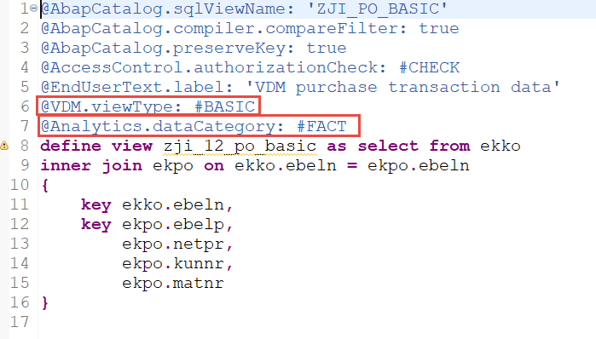
Data Category : Fact

Slide 74
Data Category : Cube
@AbapCatalog.sqlViewName: 'ZJI_COMP_PO1'
@AbapCatalog.compiler.compareFilter: true
@AbapCatalog.preserveKey: true
@AccessControl.authorizationCheck: #CHECK
@EndUserText.label: 'VDM composite PO and master data'
@VDM.viewType: #COMPOSITE
@Analytics.dataCategory: #CUBE
define view zji_12_comp_po_det as select from zji_12_po_basic as _po
association [0..1] to zji_12_material_basic as _mat on _po.matnr = _mat.matnr
association [0..1] to zji_12_customer_basic as _cust on _po.kunnr = _cust.kunnr
association [0..1] to I_MaterialText as _matxt on _mat.matnr = _matxt.Material
{
key _po.ebeln,
key _po.ebelp,
_po.netpr,
_po.kunnr,
_po.matnr
}

Slide 75
VDM Type: Consumption
@AbapCatalog.sqlViewName: 'ZJI_CONS_V1'
@AbapCatalog.compiler.compareFilter: true
@AbapCatalog.preserveKey: true
@AccessControl.authorizationCheck: #CHECK
@EndUserText.label: 'VDM consumption view'
@VDM.viewType: #CONSUMPTION
@OData.publish: true
define view zji_12_consum as select from zji_12_comp_po_det
{
key ebeln,
key ebelp,
netpr,
kunnr,
matnr
}

Slide 76
Agenda
1
CDS Views Introduction
2
Create CDS View
3
Cardinality
4
Table function
5
VDM type and data category
6
Annotation

Slide 77
Annotation
A note of explanation/extra information
Something need to added or some additional information to be delivered base on your requirement or some additional informations to your end users
Allow the data to another component– Odata service, Analytics and so on
CDS 1
Data / Model /
Metadata
DB
CDS 2
CDS 3

Slide 78
Annotation -- Classifications
ABAP Annotations
Evaluated in ABAP runtime environment.
Component Annotations
Evaluated by the frameworks of other software components.
Annotation array [ ]
More than one field/value is applicable.
[ { field1: value, field2: value …} ]

Slide 79

Annotation–Position of the annotations located
Header level Annotations
Body/Column level Annotations

Slide 80
ABAP Annotation
AbapCatalog-Annotations
AccessControl-Annotations
ClientDependent-Annotations
ClientHandling-Annotations
DataAging-Annotations
EndUserText-Annotations
Environment-Annotations
MappingRole-Annotations
Metadata-Annotations
Semantics-Annotations
Can be evaluated by ABAP framework and be evaluated by other
components framework.

Slide 81
Other Framework specific Annotations
Analytics-Annotations
AnalyticsDetaiIs-Annotations
Consumption-Annotations
DefaultAggregation-Annotations
EnterpriseSearch-Annotations
Hierarchy-Annotations
OData-Annotations
ObjectModel-Annotations
Search-Annotations
Semantics-Annotations
UI.Annotations
VDM-Annotations
Requested by specific software components like ODATA, UI and Analytics..

Slide 82

Example of ABAP Annotations
annotation 的效果在 eclipse or hana studio 看不出來, 必須利用 ABAP program 才能呈現
CL_SALV_gui_table_ida=>create_for_cds_view('zji22_abap_anno')->fullscreen( )->display( ).

Slide 83
Analytics Annotations
Only CDS as a source for Analytics, not the direct DB table.
@Analytics.query:true
Table一RSRREPDIR
Available in RSRT transaction

Slide 84

Analytics Annotations
Only CDS as a source for Analytics, not the direct DB table.
@Analytics.query:true
Table一RSRREPDIR
Available in RSRT transaction

Slide 85
Annotations dependency
@Analytics.query:true
@AnalyticsDetails.query.formula: ‘Field1 + Field2 * Constant Value’
Annotations work depends on other properties as well
Consumption View
@VDM.viewType : #CONSUMPTION
@DefaultAggregation : #SUM
Cube category
@Analytics.dataCategory: #CUBE
@DefaultAggregation : #SUM

Slide 86


Example of Annotations dependency

Slide 87

Evaluating Annotations in Query Monitor(RSRT)
@Analytics.query: true

Slide 88

Evaluating Annotations in Query Monitor(1/4)
Tcode : RSRT

Slide 89

Evaluating Annotations in Query Monitor(2/4)
With Annotation @AnalyticsDetails.query.axis: #ROWS

Slide 90

Evaluating Annotations in Query Monitor(3/4)
With Annotation @AnalyticsDetails.query.sortDirection: #DESC

Slide 91

Evaluating Annotations in 報表監視器(4/4)
With Annotation @DefaultAggregation: #SUM

Slide 92
Data Control Language(DCL)
It restricts the data returned from a CDS entity.
Literal conditions
PFCG Conditions
Different combinations are also allowed
DEINFE ROLE <rolename>(
GRANT SELECTON <CDS entity name>
WHERE<condition>;
Condition :
Normal WHERE condition(s)
PFCG authorization field values
Combination of both

Slide 93
Authorization Annotation
Annotation : @AccessControl.authorizationCheck
Value
#CHECK
#NOTALLOWED
#NOT_REQUIRED
#PRIVILEGEDONLYLiteral conditions
Header level

Slide 94
Authorization Annotation(1/9)
Annotation : @AccessControl.authorizationCheck
Value
#CHECK
#NOTALLOWED
#NOT_REQUIRED
#PRIVILEGEDONLYLiteral conditions
Header level

Slide 95

Authorization Annotation(2/9)
@AccessControl.authorizationCheck: #CHECK

Slide 96



Authorization Annotation(3/9)
Create Access control

Slide 97

Authorization Annotation(4/9)
Create Access control

Slide 98


Authorization Annotation(5/9)
Before Access control
After Access control

Slide 99

Authorization Annotation(6/9) -- Using authorization object instead of where condition
create auth object
Create role through PFCG and assign this authorization object
Assign role to user
Modify Access Control

Slide 100
Authorization Annotation(7/9)
@AccessControl.authorizationCheck: #NOT_ALLOWED
not allowed is the exact opposite of check
@AccessControl.authorizationCheck: #NOT_REQUIRED
If there is a DCL, it will be executed. If there is no DCL, there will be no warning message.

Slide 101

Authorization Annotation(8/9)
@AccessControl.authorizationCheck: #PRIVILEGED_ONLY
Data cannot be accessed directly and cannot be exposed to Odata service

Slide 102

Authorization Annotation(9/9)
Run /iwfnd/maint_service to add Odata service
Test with SAP gateway client

Slide 103
Virtual Element (1/3)
What are the Virtual Elements and Why we use that? Sometimes when we make a report, we need calculations for fields and we can not easily make calculations with CDS so that their values can be calculated directly on SAP HANA. Virtual elements represent temporary fields in applications. They are defined consumption CDS view with annotations within the SELECT list. However, the field calculations display by Abap classes that implement the specific code exit interfaces provided for this purpose.
ABAP resource – Logical / FM / BAPI
CDS View/Entity
DB

Slide 104
Virtual Element (2/3)
Annotations
@ObjectModel.virtualElement : true
@ObjectModel.virtualElementCalculatedBy : <ABAP Class Name>
@Odata.pub1ish : true
ABAP Class
Interface : IF_SADL_EXIT_CALC_ELEMENT_READ
Methods : GET_CALCULATION_INFO & CALCULATE

Slide 105
Virtual Element (3/3)
Communication between CDS and ABAP class, inside CALCULATE method
IF_SADL_EXIT_SORT_TRANSFORM
IF_SADL_EXIT_FILTER_TRANSFORM
CALCULATE : ITAB -> CDS view
IT_ORIGINAL_DATA => ITAB
Modify ITAB
ITAB => CT_CALCULATED_DATA

Slide 106

Example of Virtual Element(1/4)
Create CDS view

Slide 107


Example of Virtual Element(2/4)
Create and practice class

Slide 108

Example of Virtual Element(3/4)
Create Odata Service，Run /iwfnd/maint_service

Slide 109

Example of Virtual Element(4/4)
Evaluating in SAP gateway client

Slide 110


Extend CDS View
Extend the Standard CDS view with custom fields

Slide 111

CDS View - Date Functionalities
Current date : @Environment.systemField: #SYSTEM_DATE
With parameters addition.
It is an optional parameter and open for user input as well.
Use the parameter field for further calculation in the CDS view.

Slide 112

CDS View - Date Functions
Date Functions and Time Functions

Slide 113
CDS View - Unit and Currency Conversion
Unit Conversion
quantity
source_unit
target_unit
Currency Conversion
amount
source_currency
target_currency
Exchange_rate_date

Slide 114

Example of Unit and Currency Conversion

Slide 115
Thank you

